Slide 1
Evolution over time of the structure of social graphs
Student Leonardo Serilli
Supervisors Nicolas Nisse, Malgorzata Sulkowska, Frédéric Giroire
Year 2021/2022

Slide 2
INTRODUCTION
01
STATE OF THE ART
02
DEGREE DISTRIBUTION
DATA PREPARATION
TABLE OF CONTENTS
04
03
VERTEX TRAJECTORIES
05
06
CONCLUSION
Context
Scope of the project
Scale-free networks
Vertex trajectories
Theoretical model
Degree Distribution Retrieval
Degree Distribution Fitting
Data Retrieving
Filtering Active Authors
Definition of Event
Average Trajectories
Stretching
Fitting Trajectories
General Fitting
Reducing The Error

Slide 3
01
Introduction
Context
Scope of the project

Slide 4
CONTEXT
Part of a larger project involving researchers in fields, such as economics, sociology and computer science. Focused on the evaluation of the impact of funding on scientific research.
Example of funding: LabEx and IdEx. French programs whose scope is to promote collaborations involving different research fields.
Data composed of 258145 French computer science authors with their collaborations and publications from 1990 to 2018.

Slide 5
SCOPE OF THE PROJECT
Build a network of scientific authors and their collaborations, collected from the Scopus database in order to analyze the distribution of their collaborations over time.
Collaboration network: a set of nodes (authors) connected by edges (collaborations). Two nodes are connected if there exists at least one collaboration between them.

Slide 6
02
STATE OF THE ART
Scale-free networks
Vertex trajectories
Theoretical model

Slide 7
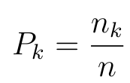
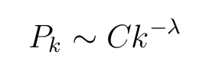
SCALE-FREE NETWORKS
Let:
G = (V, E) be a graph of n nodes.
n_k be the #nodes of degree k in G,
λ > 0 an exponential parameter,
C > 0 a scaling constant.
The degree distribution P_k of G follows a power-law if:
and
A network whose probability distribution of degrees of nodes respects the power law distribution is said to be scale-free.

Slide 8
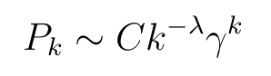
SCALE-FREE NETWORKS
Scale-free networks are not so widespread as, it turns out that many of them follow a power-law distribution with an exponential cut-off:
where 0 ≤ γ < 1 is a constant parameter of the distribution.
The experimental study showed that data we are working with also falls into ”exponential cutoff” case.

Slide 9
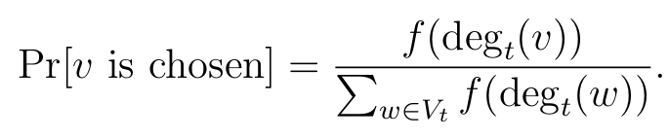
VERTEX TRAJECTORIES
Given a graph G_t = (V_t , E_t ), where t is a given time step are defined:
Node Event: a new node appears in the graph,
Edge event: a new edge appears.
New nodes and edges must select already present nodes to attach. The probability for any node v to be chosen is defined from an attachment function f(x):
Where deg_v(t) is the degree of vertex v at timestep t .

Slide 10
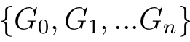
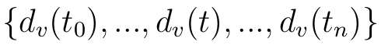
VERTEX TRAJECTORIES
Given n time steps, defined by the occurrence of an event, the evolution of a graph G_0 is the sequence:
Let:​
d_v(t) degree of vertex v at timestep t,​
t_0 timestep in which v appears.
​
=> The vertex trajectory of v is the evolution over time of it’s degree, so the sequence:

Slide 11
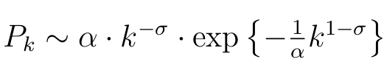
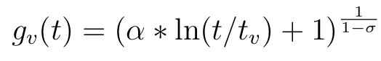
THEORETICAL MODEL
Given:
α > 0,
0 ≤ σ < 1,
t_v be the time step in which v join the network ,
f(x) = x^σ the attachment function.
The theoretical model, referred from now on, is the one illustrated next, in which: the degree distribution P_k follows a more subtle distribution than the power-law with exponential cut-off, the so-called stretched exponential:
and the vertex trajectory has logarithmic shape:

Slide 12
03
DATA PREPARATION
Data Retrieving
Filtering Active Authors
Definition of Event

Slide 13
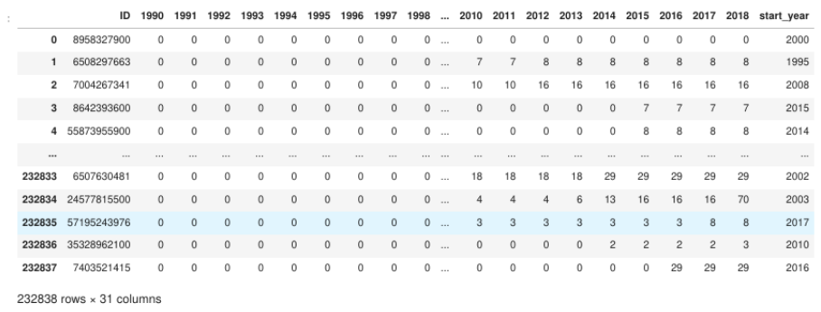
DATA RETRIEVAL
Retrieved data is about collaborations of all computer science authors in France since 1990 to 2018.

Slide 14
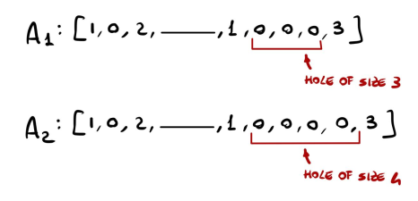
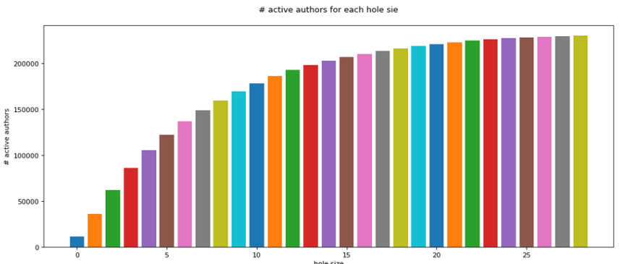
FILTERING ACTIVE AUTHORS
Given n ∈ N called hole size, an author has a hole of size n , in his publications, if he stopped to publish for n consecutive years.
Follow that the maximum hole size is the maximum number of years he has passed without publishing.
An author is inactive for a given hole size if he has a hole, in his publication data, greater than the given hole sizes.
For each possible hole size, has been built a dataset where all authors considered inactive, have been filtered out.

Slide 15
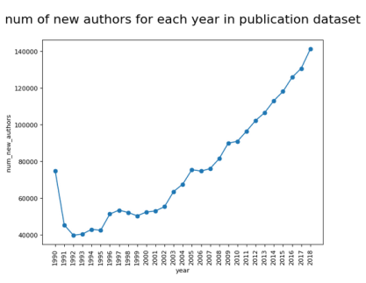
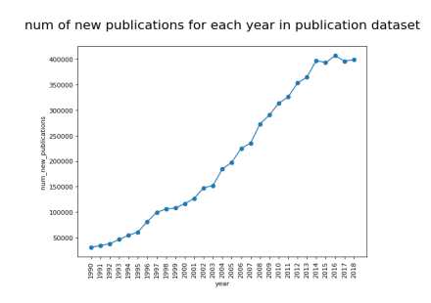
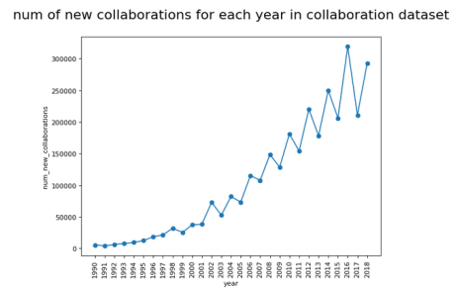
DEFINITION OF EVENT
The theoretical model, as a time step, consider events, so the set of year, containing only 28 time step, can be too small in order to build meaningful vertex trajectories.
Other metrics are so considered: the occurrence of a new publication, of a new author or a new collaboration.

Slide 16
04
Degree Distribution
DEGREE DISTRIBUTION RETRIEVAL
DEGREE DISTRIBUTION FITTING

Slide 17
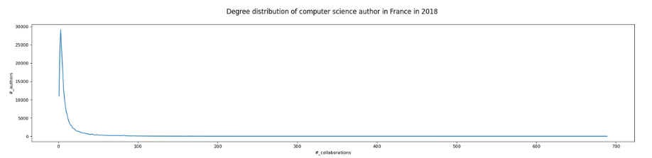
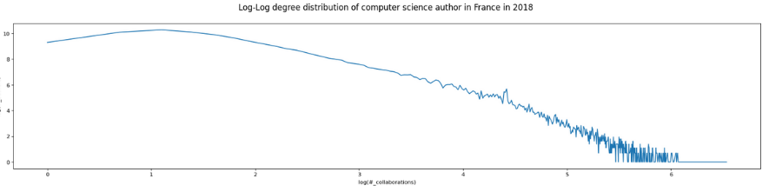
DEGREE DISTRIBUTION RETRIEVAL
To acquire more knowledge from the character of the data the degree distribution is found, taking the #authors with a given #collaborations. ​

Slide 18
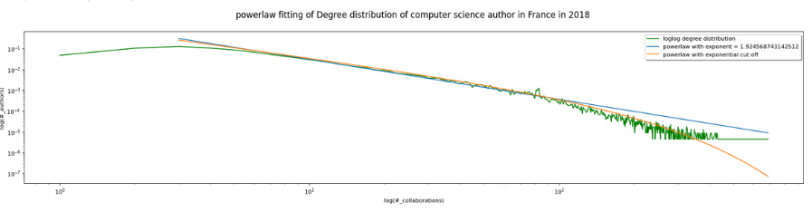
DEGREE DISTRIBUTION FITTING
Fitting the given distribution with the power-law, both the classic and the one with exponential cut-off.
Results that a power-law with exponential cut-off is better for it's fitting. ​

Slide 19
05
VERTEX TRAJECTORIES
Average Trajectories
Stretching
Fitting Trajectories
General Fitting
Reducing The Error

Slide 20
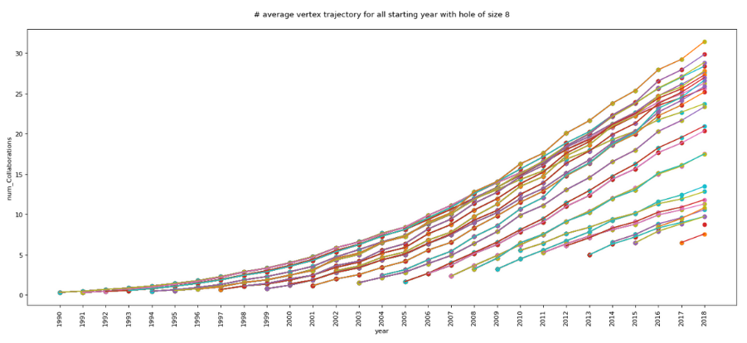
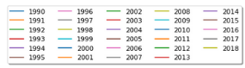
AVERAGE TRAJECTORIES
In order to refer to the theoretical model described in the state of the art, is computed and plotted the average trajectory of authors by starting year.

Slide 21
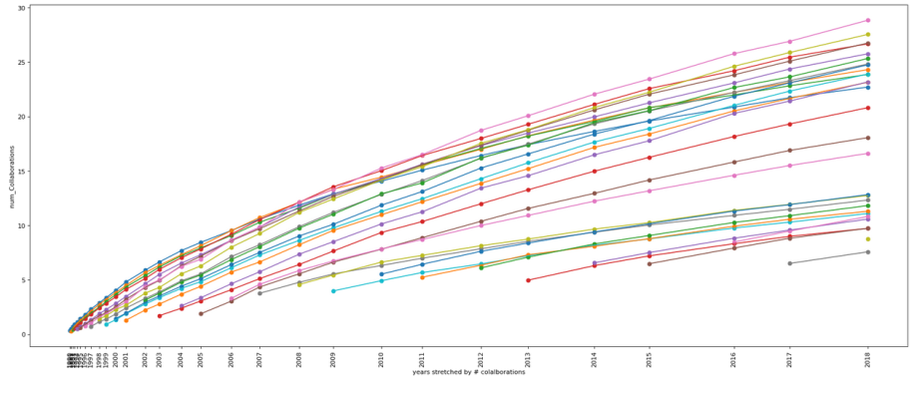
STRETCHING
For the fitting presented in the next section, considering the number of new collaborations as event, brings to better results. ​
This metric results in a stretch over the x-axis of the previously presented curves. ​

Slide 22
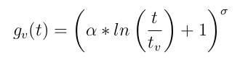
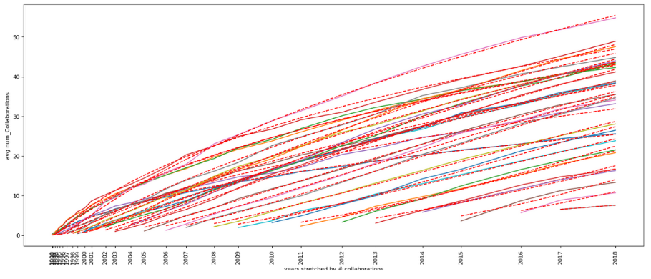
FITTING TRAJECTORIES
Average trajectories are fitted one by one using the logarithmic function representing the theoretical vertex trajectory.
The fitting works better for trajectories with a low starting year, they contain enough data to show the logarithmic behavior we are trying to fit.

Slide 23
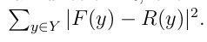
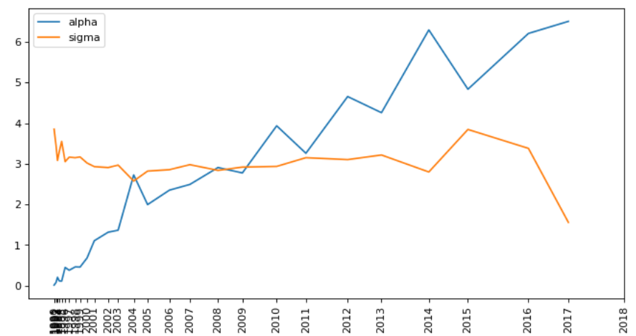
GENERAL FITTING
Then has been tried to find the best couple of parameters α and σ able to fit all curves minimizing the total error on the fitting.
Given the original function R, the fitted one F and the set of all years Y the error ϵ is.
ϵ = 45890.73.
An explanation behind the big error can be the fact that alpha grows linearly (next image) while we impose a constant behavior to it.

Slide 24
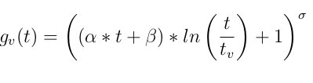
REDUCING THE ERROR
To reduce the error a new variable β is introduced to capture the linear behavior of alpha with a new function.
In this case ϵ = 11895, clearly better than before.​

Slide 25
06
CONCLUSION

Slide 26
CONCLUSION
During this study we discovered that the underlying theoretical model is probably more complex than we assumed at the beginning. ​
​
Nevertheless, our research may be seen as a step forward in constructing functions representing well the evolution of the node degree in the networks.​
A next step for this work could be to analyze data coming from other research field than computer science, to see, if they bring to same, or even better, results.

Slide 27
